Slide 1


WIPRO CAPSTONE PROJECT C-2 GROUP- 12
TITLE: SHOP FOR HOME
PRESENTED BY:
A. SUMANA SREE
NEELA. SIRISHA
MENTOR:
PARTH SHUKLA

Slide 2
PROBLEM STATEMENT:
TO DEVELOP A DYNAMIC E-COMMERCE HOME DECOR SHOPPING WEBSITE AS ALL OFFLINE STORES HAVE MOVED TO ONLINE MODE.

Slide 3
Objectives:
Provide visitors a personalized experience.
Make website responsive
Improve customer loyalty
Refine service efficiency
Establish deeper business relationship

Slide 4
Software requirements for developing the application.
Application server :Spring Boot
IDE : Eclipse IDE for Java EE Developers (BackEnd) & Visual studio code.
System : Windows7 /8/8.1/10
Database: MySQL
Software requirements for running the application
Operating system : Windows7 /8/8.1/10.
Network : Wi-Fi or Cellular Network.

Slide 5
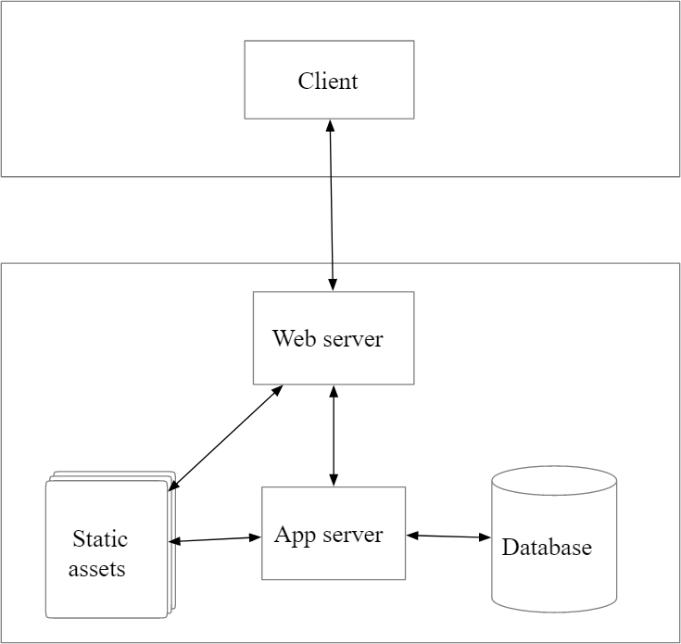
Working:

Slide 6
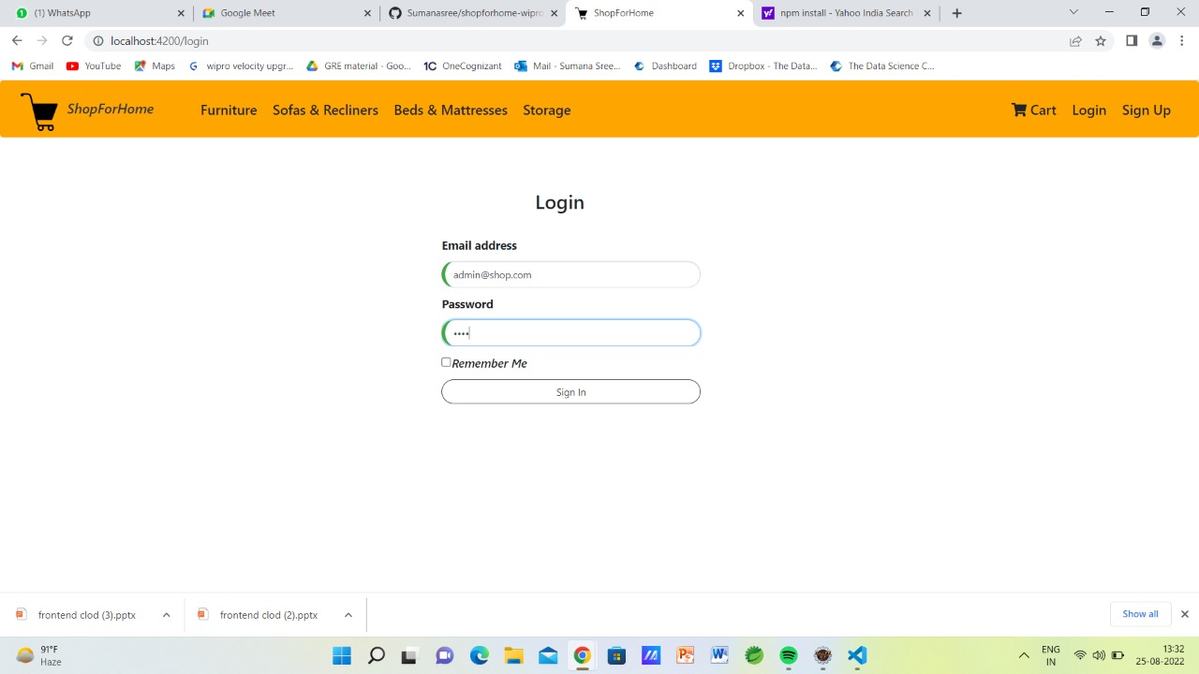
ADMIN PAGE:
This is our admin login page.

Slide 7
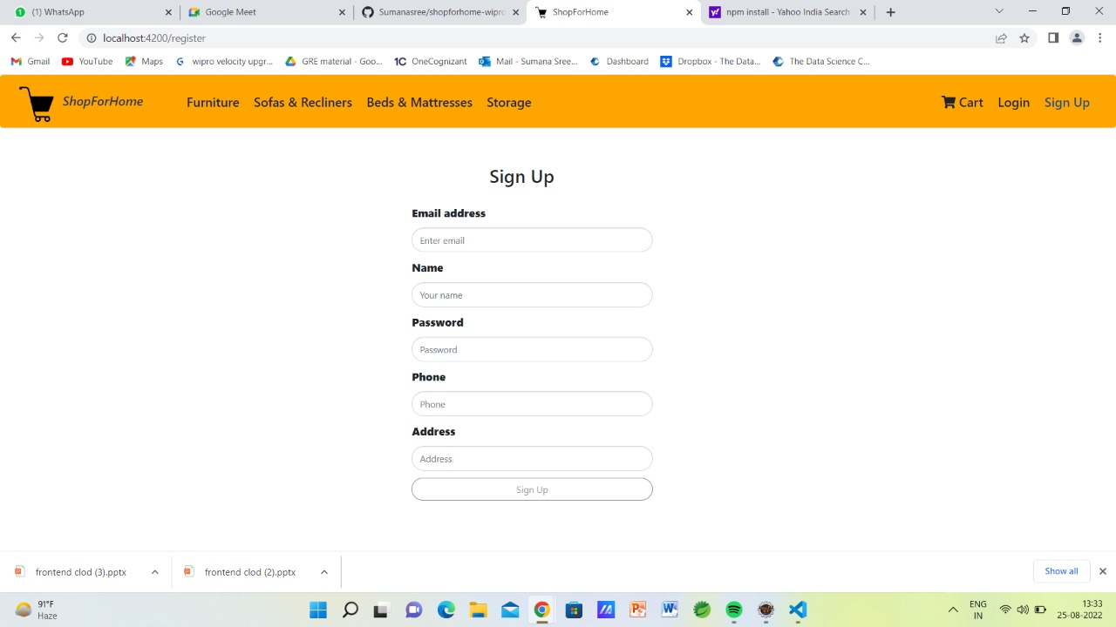
Register page:
Here one can register as user.

Slide 8
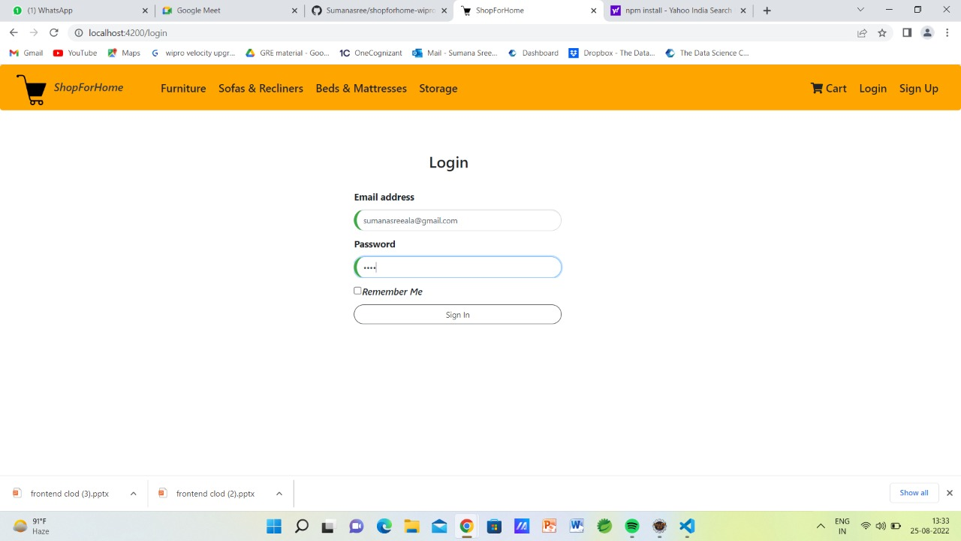
USER PAGE:
This is our user login page.

Slide 9
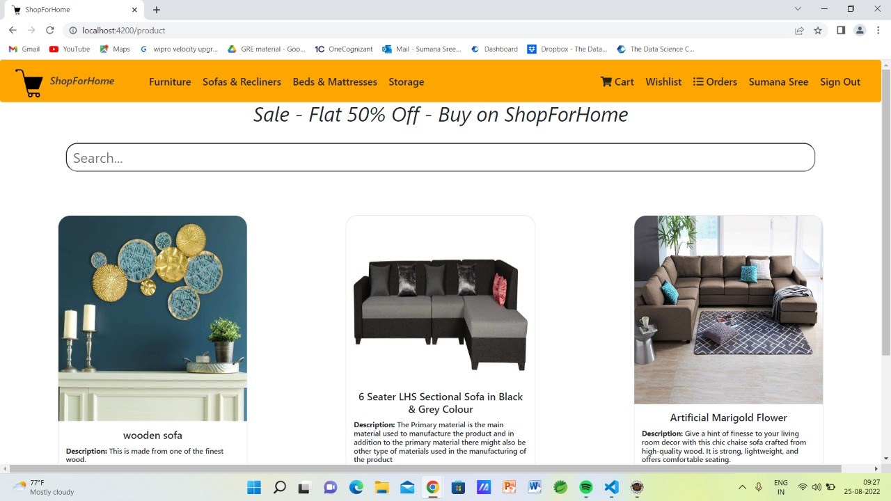
Home page:
The user home page contains products, cart and wishlist.

Slide 10
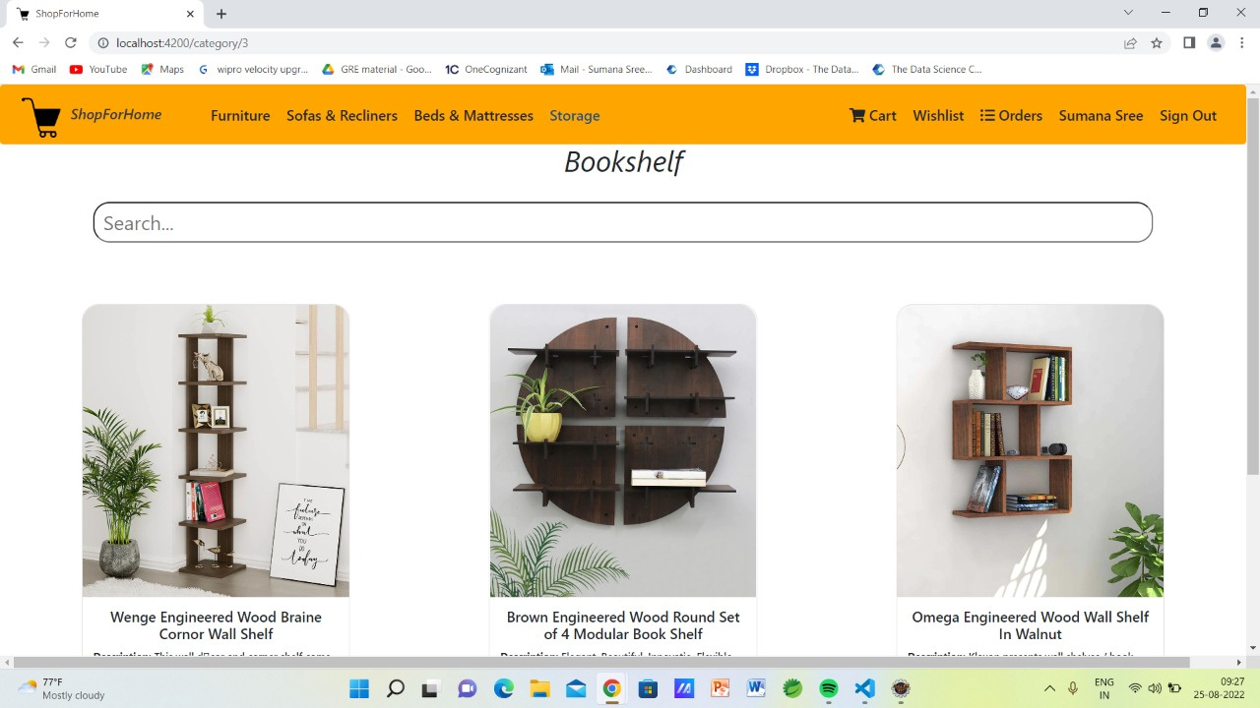
Featured products:
These are the Featured Products in the Home page for display.

Slide 11
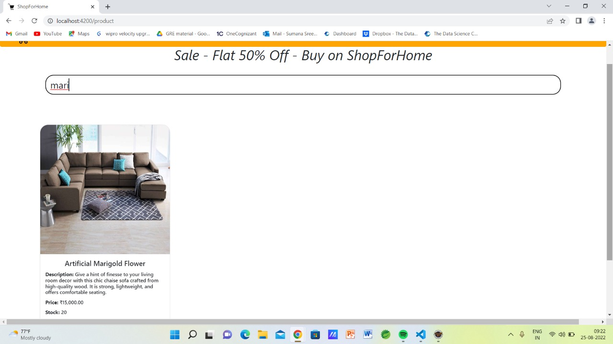
Search option:
Here we can also included a search functionality where a user can type specific product name to get that product instead of going through all the products.

Slide 12
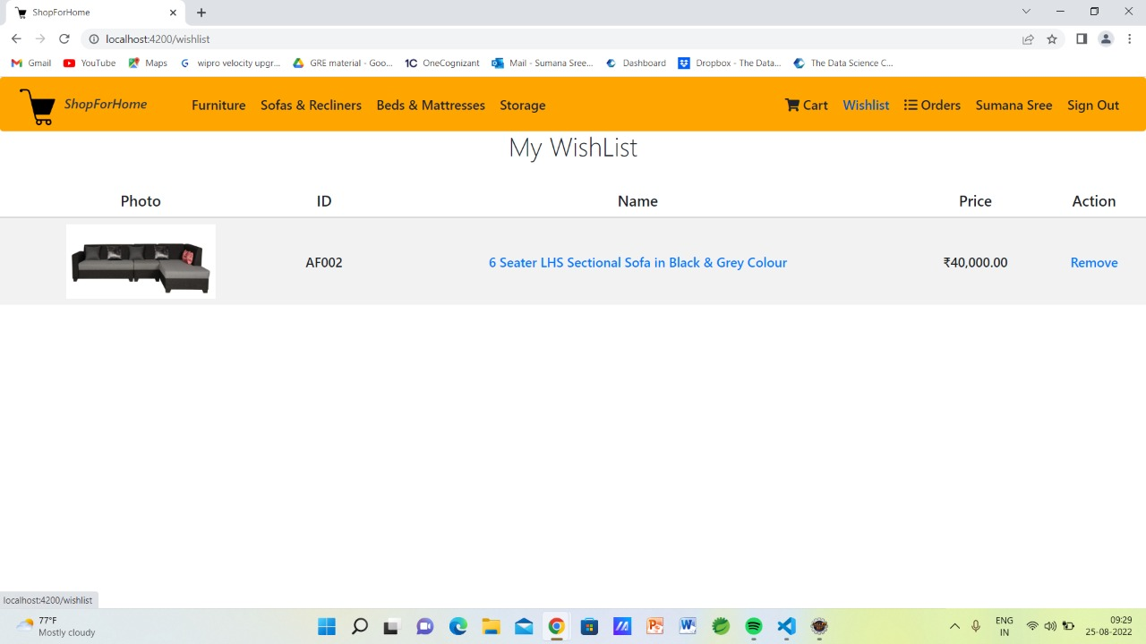
Wishlist:
User can add products to Wishlist simply by clicking on the Wishlist heart button and all the products will be visible in the Wishlist icon.

Slide 13
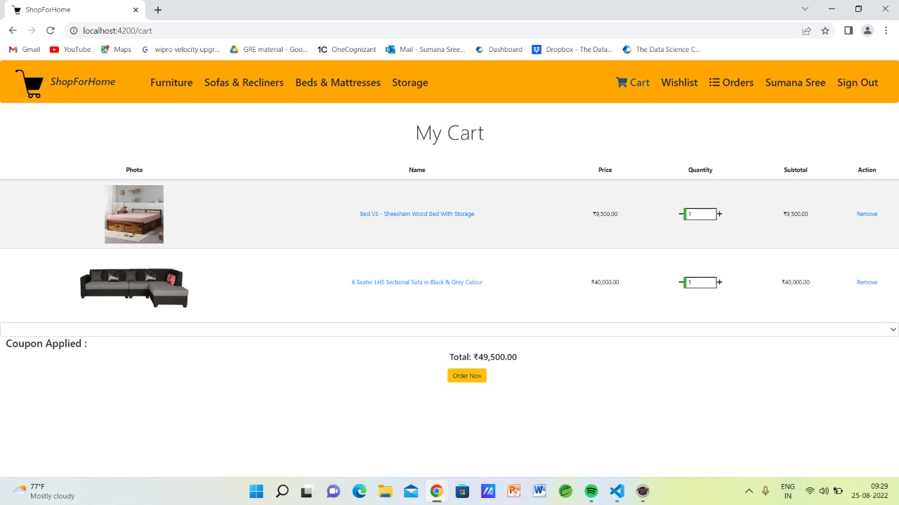
Shopping cart:
After the User clicks on “Add to cart” button, the products will be automatically added to the carts and the user can see the added products by simply clicking on cart option.

Slide 14
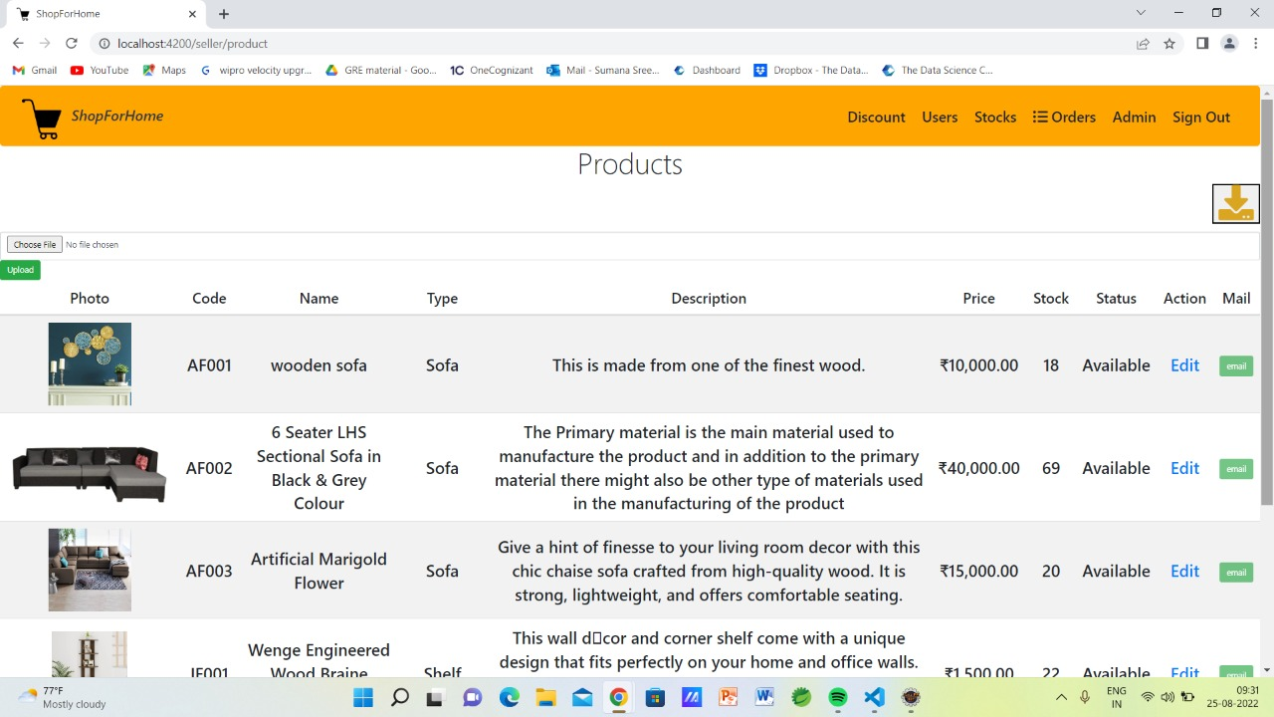
stocKs:
Admin has access to perform CRUD operations on Users and Products and also has possibility to look at the stocks.

Slide 15
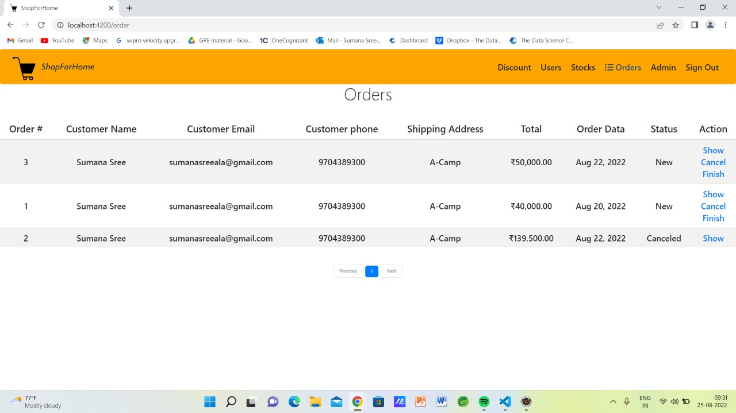
SALES REPORT:
Here we can get the details of orders placed by users.

Slide 16

discount:
Here we have given a coupon of discount flat 50.

Slide 17
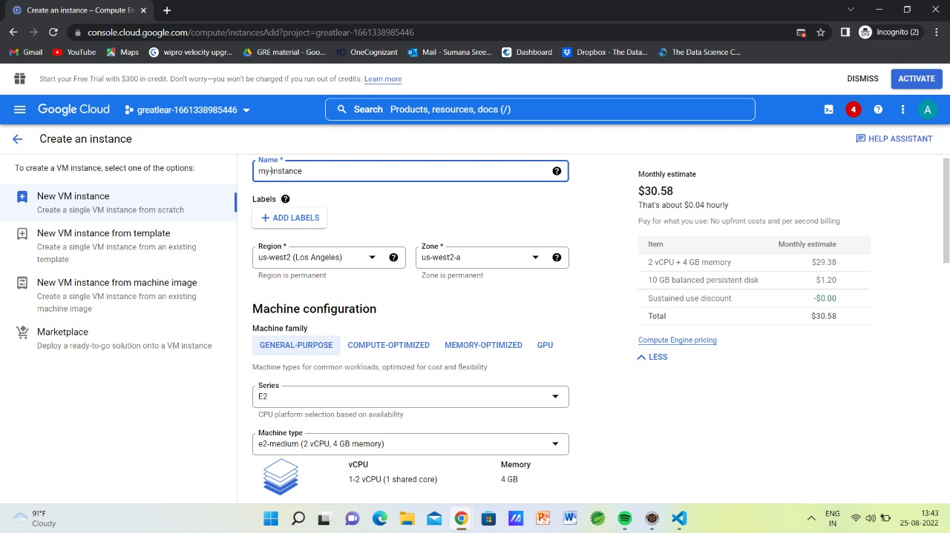
deployment:

Slide 18
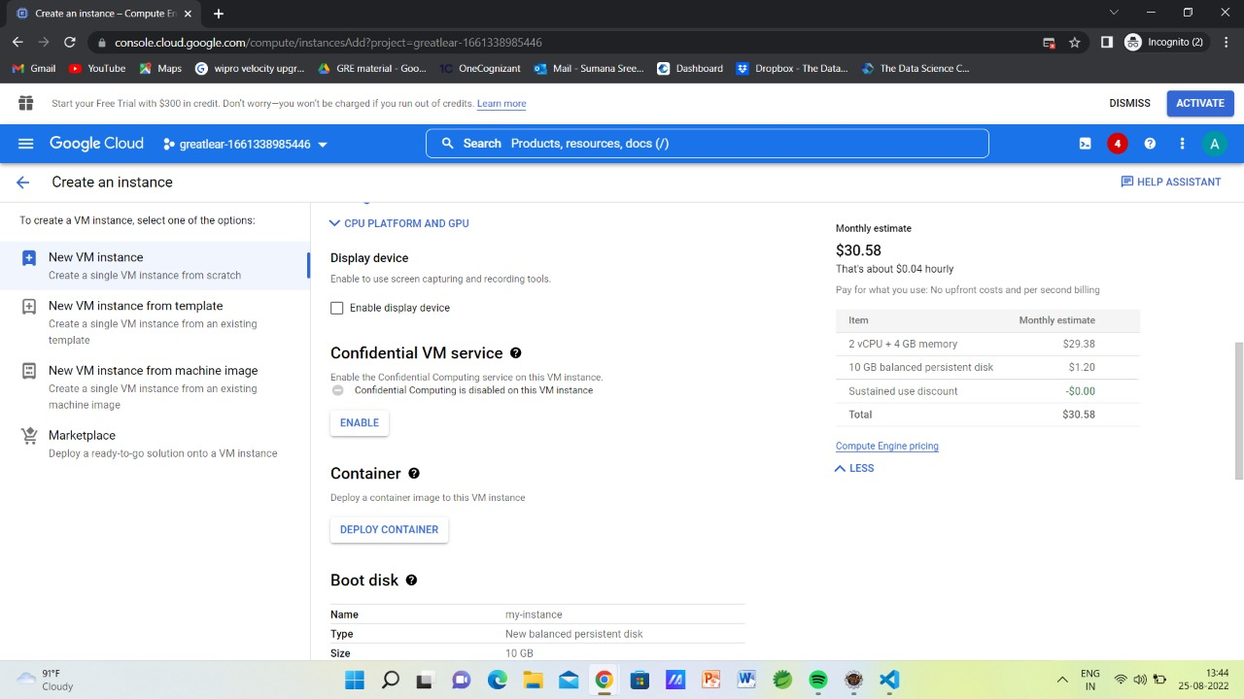

Slide 19
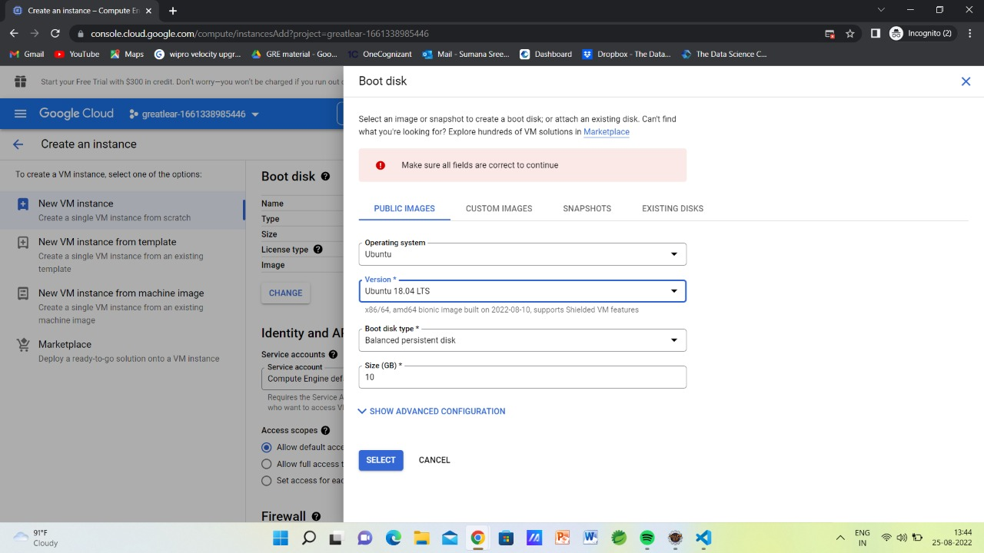

Slide 20
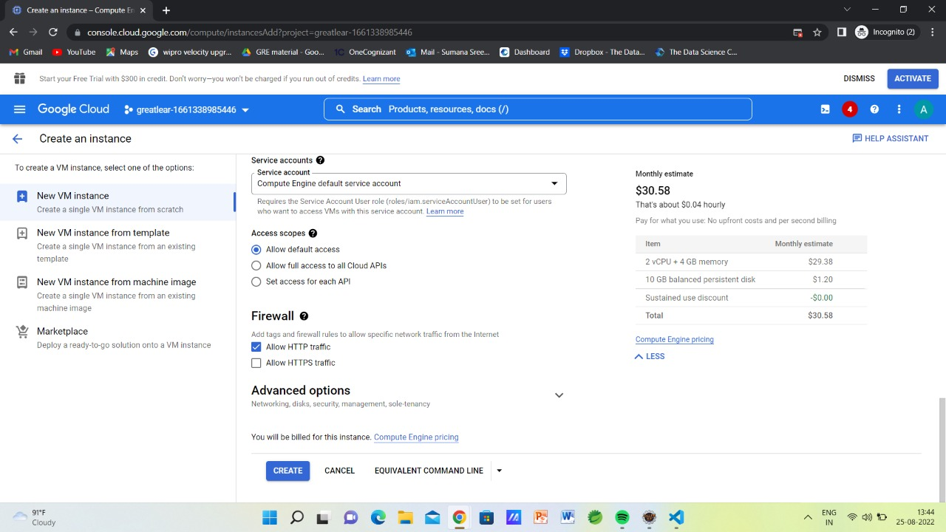

Slide 21
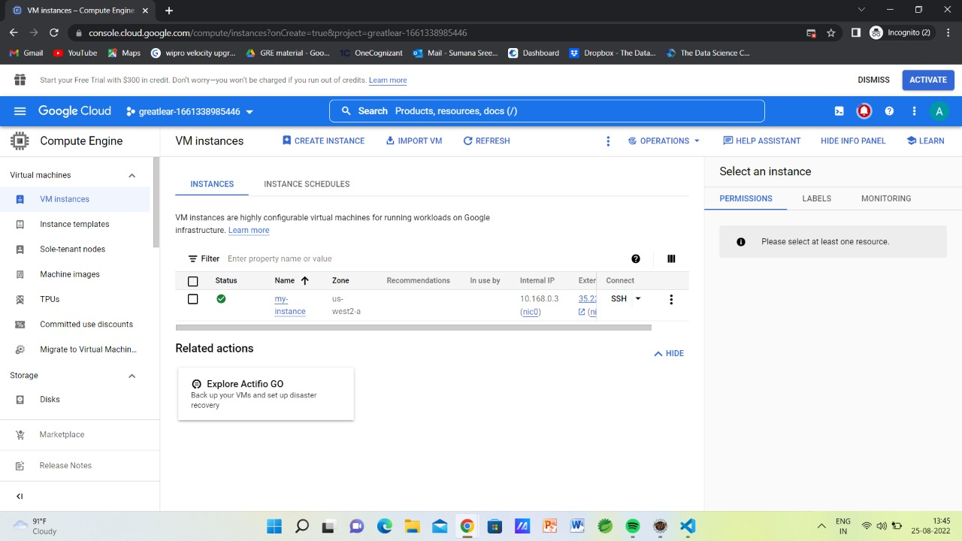

Slide 22
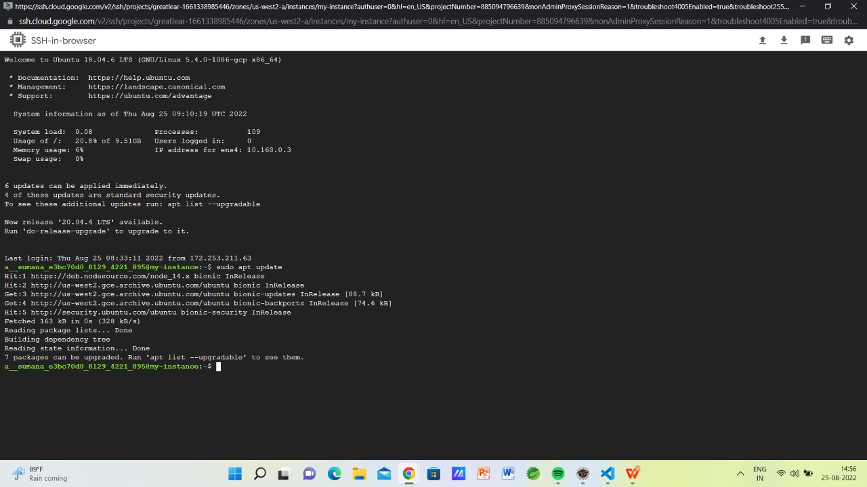

Slide 23
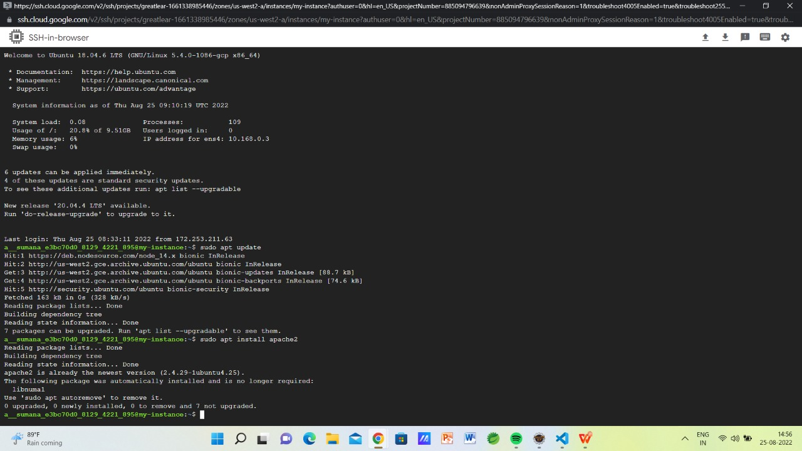

Slide 24
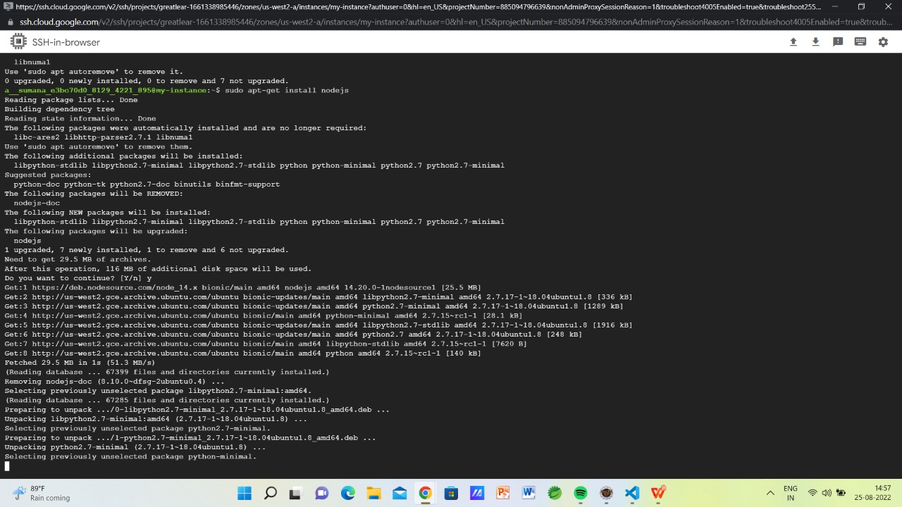

Slide 25
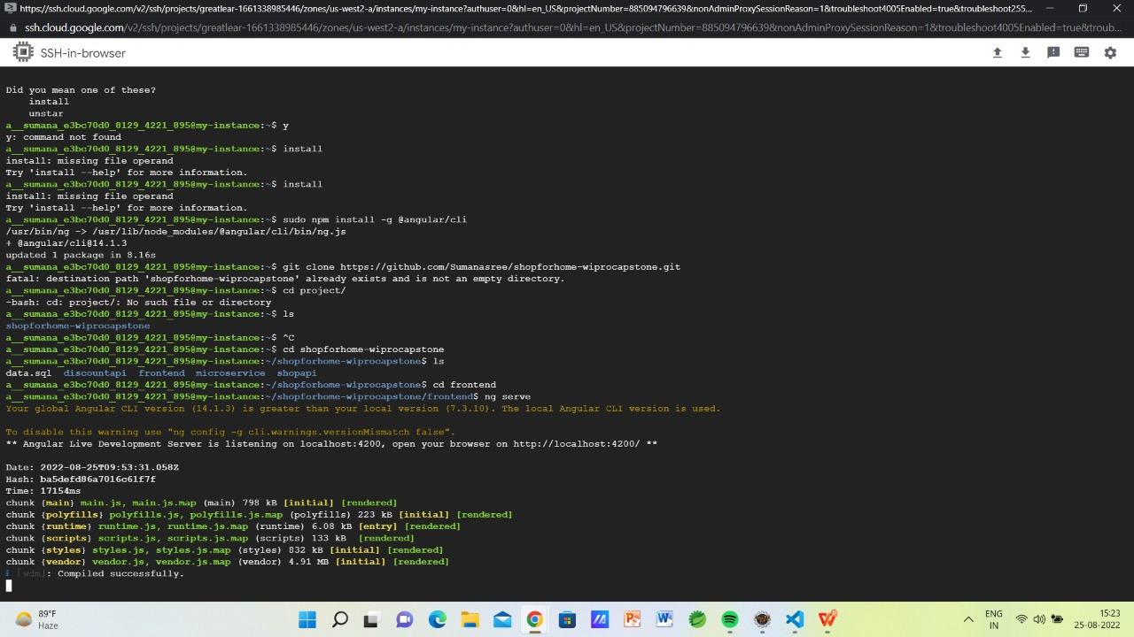

Slide 26
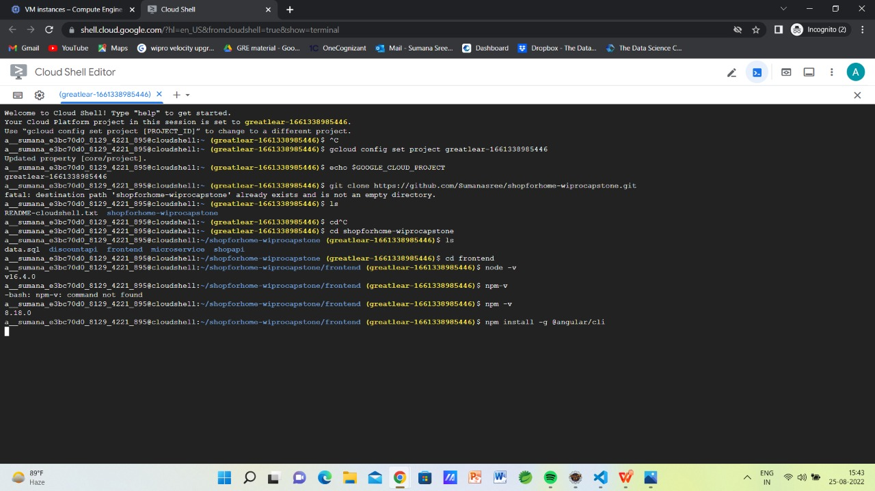

Slide 27
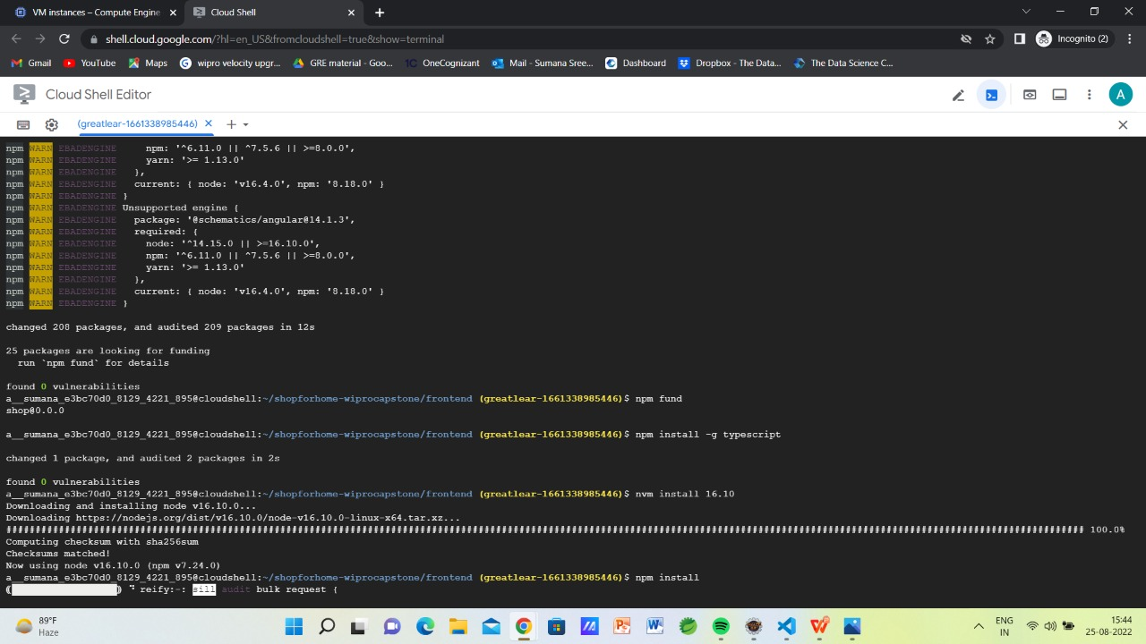

Slide 28
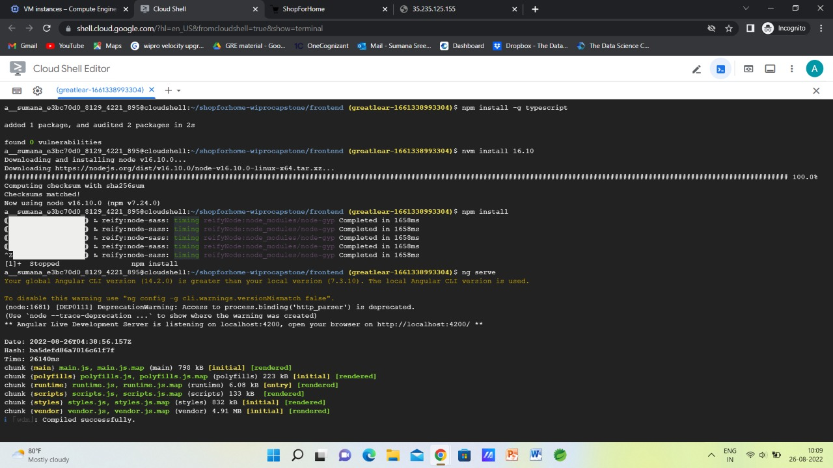

Slide 29
conclusion:
It is an user friendly application and promotes user to purchase and shop faster.
Being able to buy anytime anywhere.
Allows to place order before purchasing.
Home delivery - you don’t have to travel to shops.
Widespread effects on economy and e-commerce.

Slide 30
THANK YOU

